Slide 1
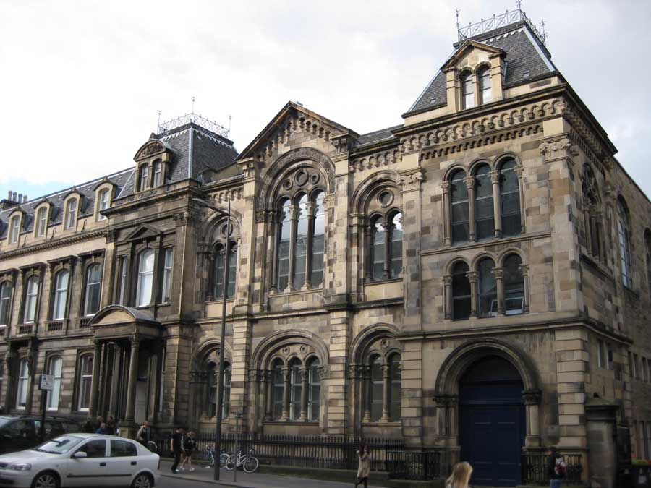
Architecture

Slide 2
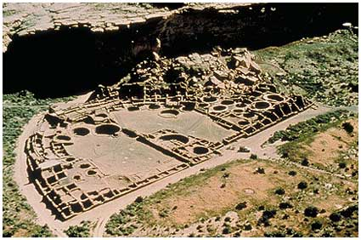
Chaco Canyon

Slide 3
located in Northern New Mexico
built in the 12th century C.E. (the golden age of the Anasazis)
lies in the ruins of Pueblo Bonito
created a complex urban civilization amid
the arid landscape of the Colorado Plateau
held the record as the world’s largest apartment house

Slide 4
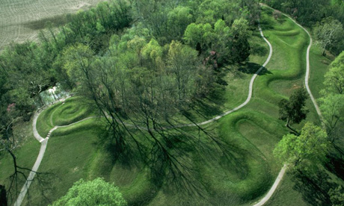
The Great Serpent Mound

Slide 5
located in Southern Ohio
The shape of an uncoiling snake
More than 1,300 feet long
Largest effigy earthwork in the world
Suggest a high degree of social organization of the Mississippian people

Slide 6
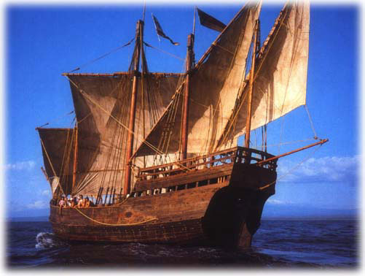
Columbus’s Nina

Slide 7
a caravel
type of vessel developed by the naval experts at Henry the Navigator’s Institution at Sagres Point, in Portugal
traditional square rigged Mediterranean ship
added the “lateen” sail of the Arabs (permitted much greater maneuverability)
Asian improvements: stern (post rubber and multiple mast)
travel further and faster than any earlier ships
made possible for the invasion of America

Slide 8
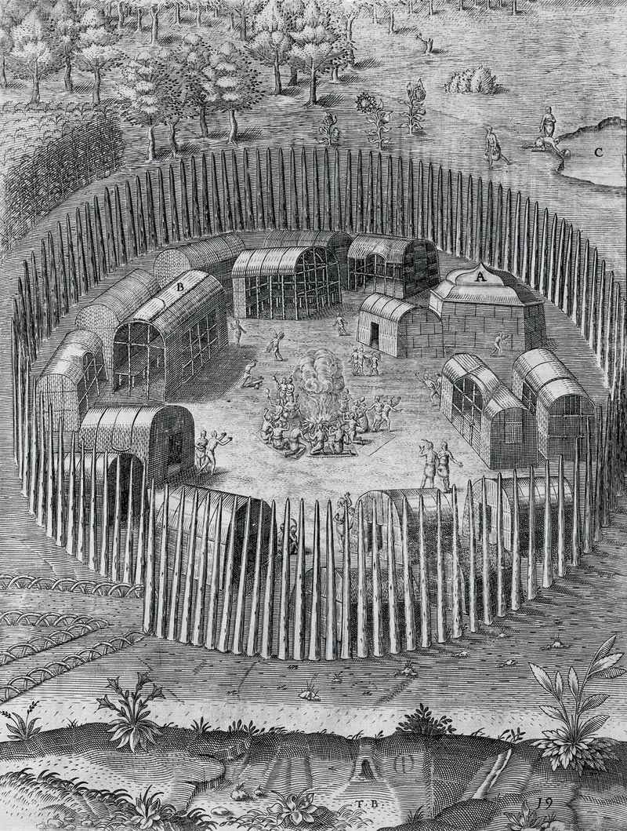
Algonquian village of Pomeiooc

Slide 9
John White sketched the painting
July 1585
a palisade enclosure with an easily guarded entrance
eighteen longhouses made a large community
only one house with a pyramid shaped roof
it was thought to be a ceremonial or religious center

Slide 10
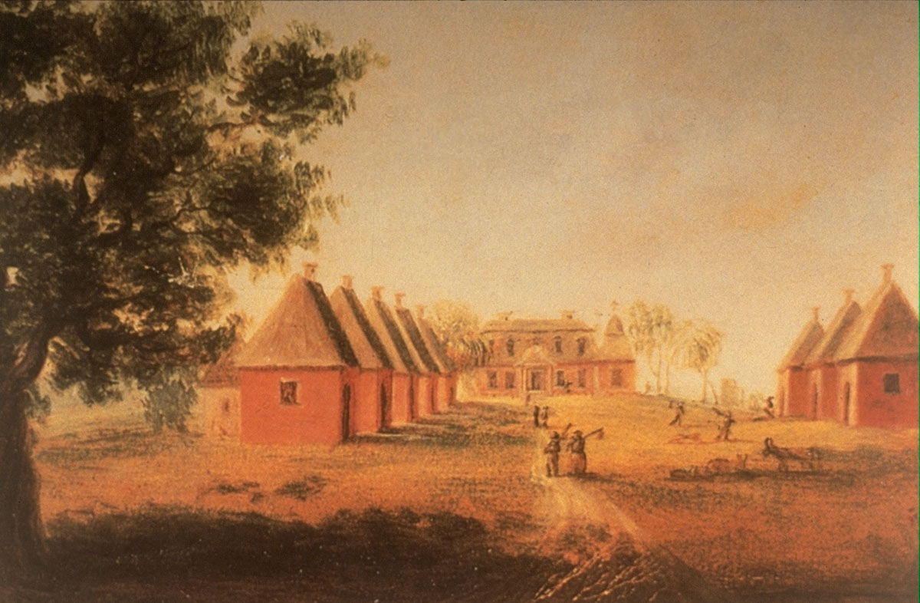
Slave Quarters of Mulberry Plantation

Slide 11
located in Charleston, South Carolina
steep roofs of the slave cabins
architectural featured introduced in America by slave builders
kept the quarters cool by allowing the heat to rise and dissipate in the rafters

Slide 12
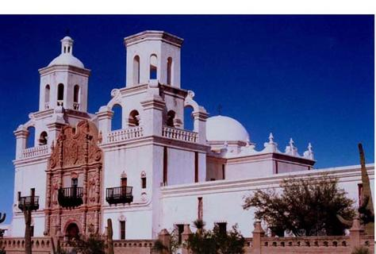
The church of San Xavier del Bac

Slide 13
constructed in the late eighteenth century
1700: Jesuit Father Eusebio Kino founded a mission among the Pima Indians
known as the White Dove of the Desert
acclaimed as the most striking example of Spanish colonial architecture in the United States

Slide 14
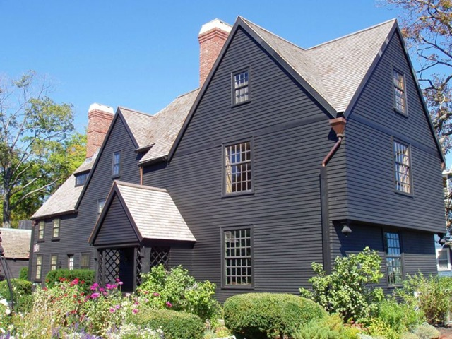
The House of the Seven Gables

Slide 15
constructed in the seventeenth century
function prevailed over form as structure grew to accommodate their residents
rooms were added where and when they were needed
In England, wood for buildings were scarce
the abundance of forests in North America created the conditions for a golden age of wood construction

Slide 16
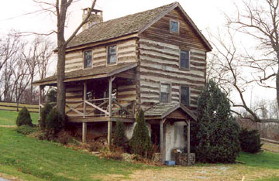
Two-story log house

Slide 17
built in the eighteenth century
located in Pennsylvania
one of the oldest surviving examples of the method and style of log construction
introduced in America by the Scandinavian colonists on the lower Delaware River
learning New World farming and woodland hunting techniques from the Indians
forged a tradition of settlement that proved enormously successful for pioneers

Slide 18
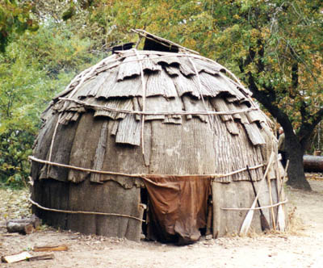
Wigwam (Wetu) Homes

Slide 19
houses used by the Algonquin Indians
woodland regions
wigwam is the word for “house” in the Abenaki tribe
wetu is the word for “house” in the Wanpanoag tribe
also known as birchbark houses
small houses, usually 8-10 feet tall
made of wooden frames
covered with woven mats and sheets of birchbark
shaped like a dome, come, or rectangle with an arched roof
ropes or stripes of wood are wrapped around the wigwam to hold the bark in place

Slide 20
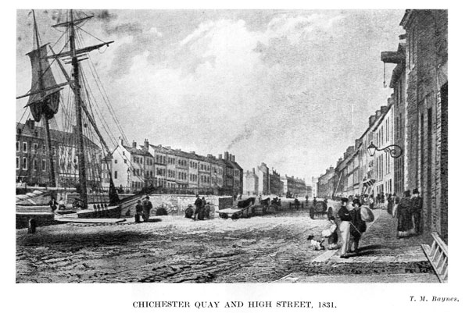
London’s Old Custom House Quay

Slide 21
made mostly of bricks to stay strong from storms and floods
built high up, not across, to avoid possible floods from storms
slanted roofs to allow the rain to fall off easily to prevent leaks in the roof
multiple windows fro light to pass through into the house
also built up to be able to spot incoming ships to dock on the port
partially made from wood
located directly on the sea wall

Slide 22
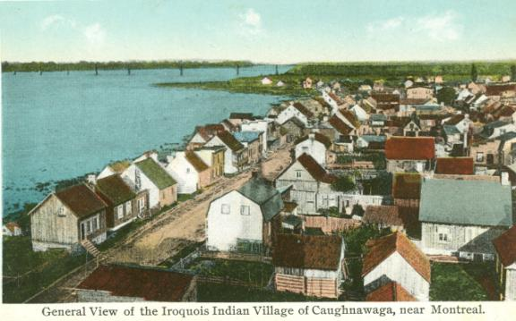
Kahnawake

Slide 23
community of Catholic Indians that lived in Deerfield, located near Montreal
farming town of about fifty or sixty homes clustered around a central church
surrounded by stockade to protect it from energy raiders

Slide 24
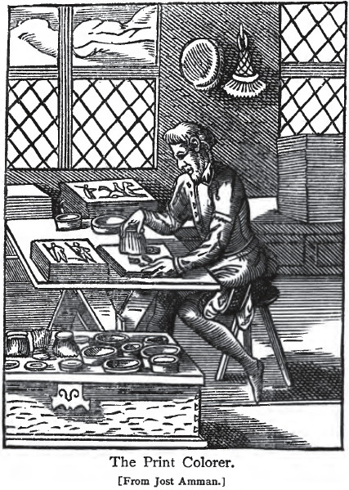
The Book of Trades

Slide 25
British carpenter making windows
women making shirts
during the 18th century
colonial artisans

Slide 26
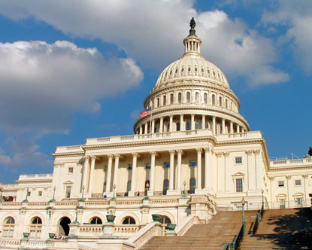
United States Capitol

Slide 27
located in Williamsburg, Virginia
completed in 1705
burned down in 1747 and then rebuilt
center of the political and social life of Virginia
where the House of Burgesses met
after the capitol moved, it was used by British forces

Slide 28
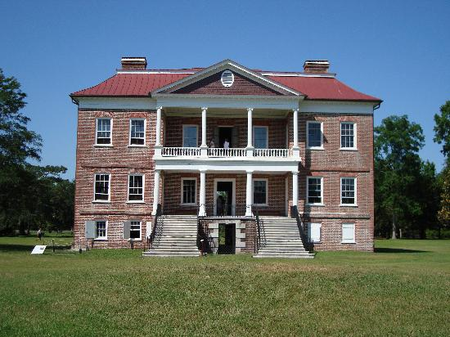
Drayton Hall

Slide 29
completed in 1742
home to over 7 generations of Drayton heirs
surrounding 630 acre estates
survived the American Revolution, the Civil War, and many hurricanes
located in Charleston, South Carolina

Slide 30
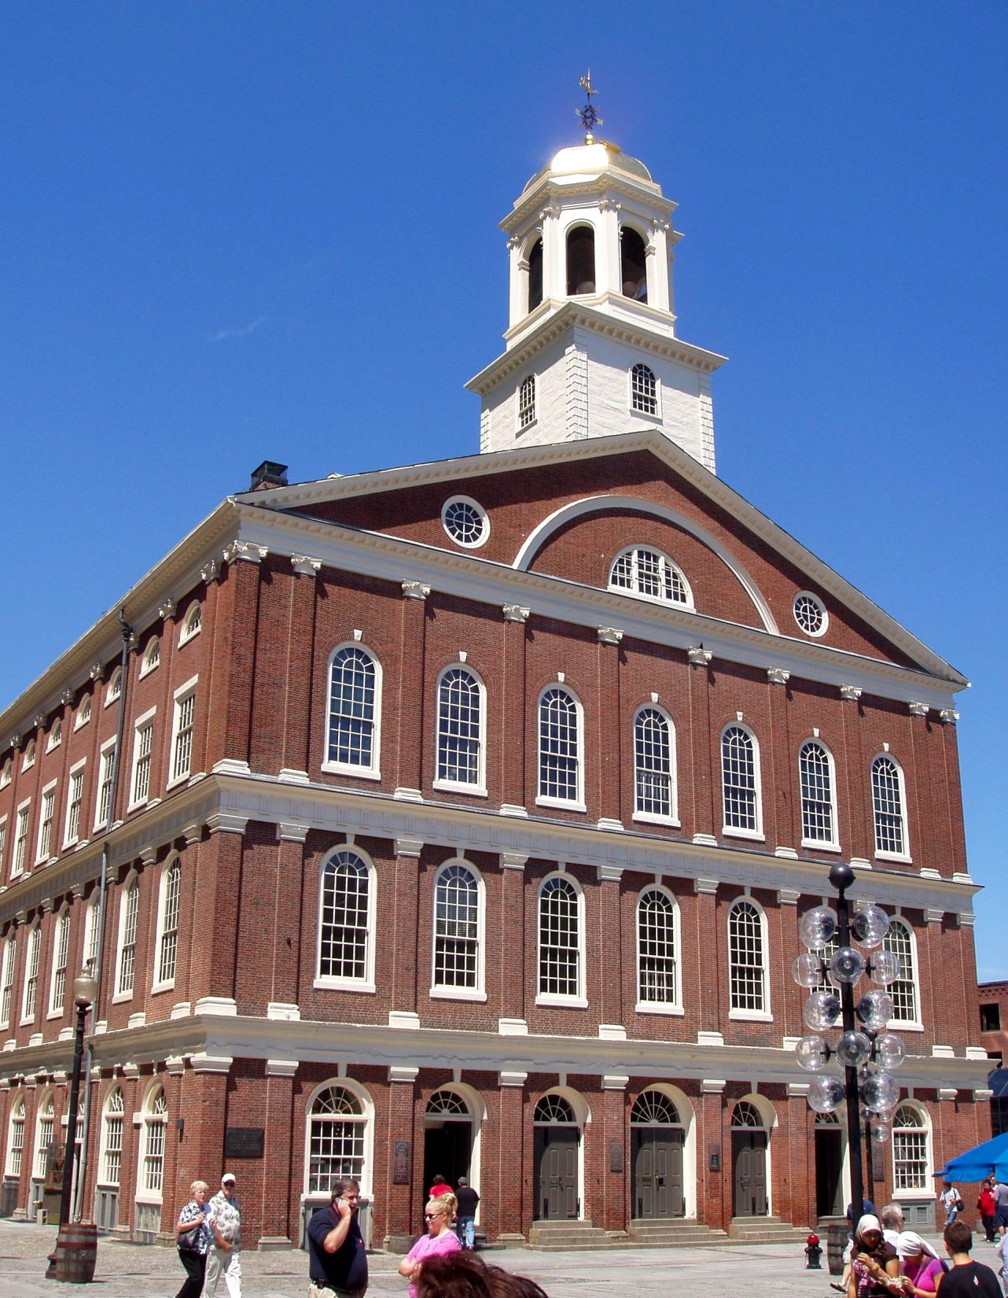
Faneuil Hall

Slide 31
located in Boston, Massachusetts
near the waterfront
a government center
a market place and meeting hall since 1742
site speeches by Samuel Adams and James Otis
encouraged independence from Great Britain
“The Cradle of Liberty”
funded by a wealthy Boston merchant, Peter Faneuil

Slide 32
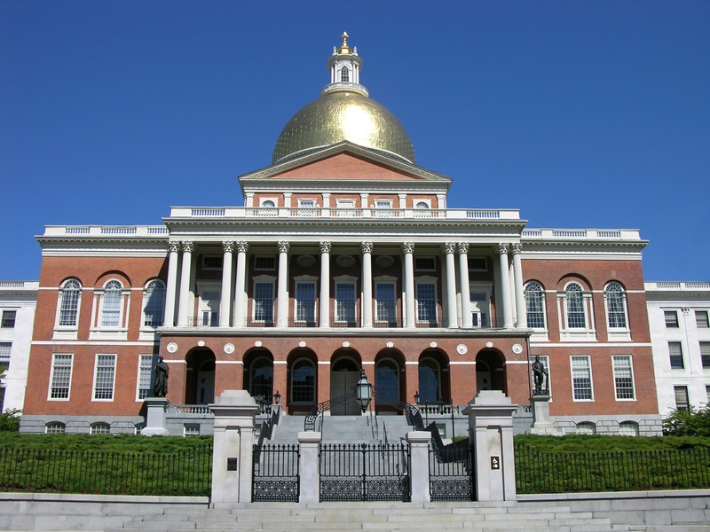
Massachusetts State House

Slide 33
commonwealth of Massachusetts
located in Beacon Hill
inspired by two London buildings
wood dome
first the dome was painted gray then light yellow
During WWII the dome was painted black
to protect the city during blackouts and bombing attacks
brick bearing masonry

Slide 34
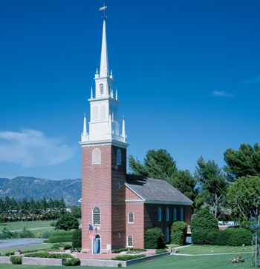
The Old North Church

Slide 35
built in 1723
Boston, Massachusetts
made from bricks with wooden spire
parish of the Episcopal Diocese of Massachusetts
the oldest active church building in Boston
National Historical Landmark in present day

Slide 36
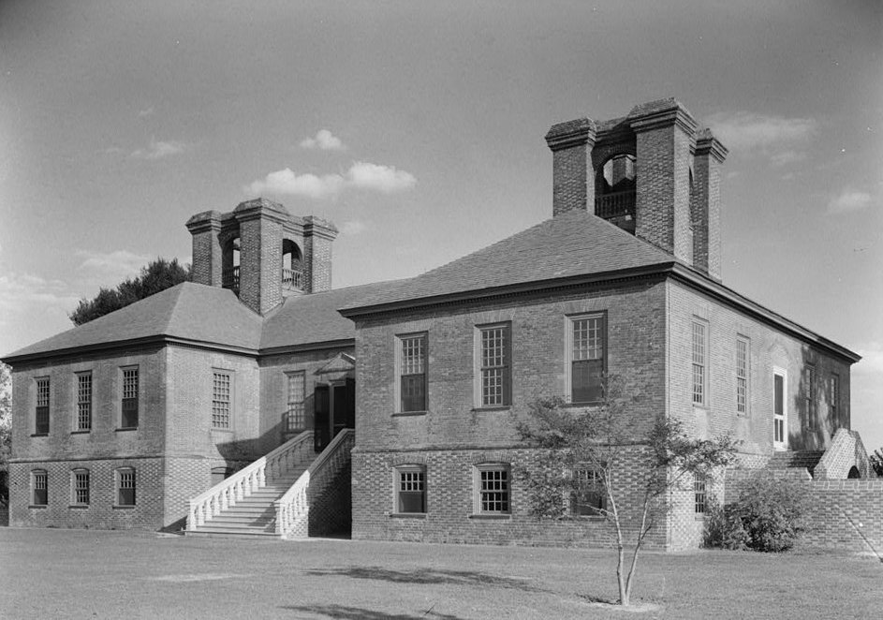
Stratford Hall

Slide 37
located in Westmoreland Country, Virginia
built in 1738
made from brick bearing masonry
home of four generations of the Lee family
birthplace of Robert Edward Lee

Slide 38
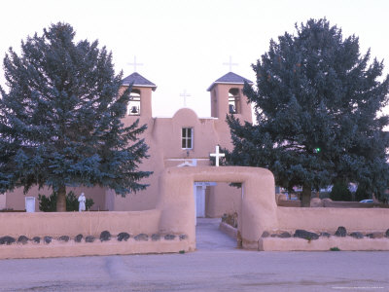
San Francisco de Asis

Slide 39
church
masonry, adobe with timber rafters
oldest surviving structure in San Francisco
6th religious settlement established as California chain of missions

Slide 40
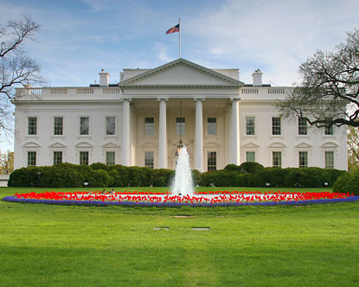
The White House

Slide 41
located in Washington, D.C.
the original building was built in 1793
later burned down in 1814
built from cut stone bearing masonry
official workplace and principle workplace of the President of the United States
design competition
received nine proposals
influenced by the first and second floors of the Leinster House in Dublin, Ireland
enlarged by 30 percent

Slide 42

Terms and People

Slide 43
arid: characterized by a severe lack of available water, to the extent of hindering or even preventing the growth and development of plant and animal life
effigy: a representation of a person or animal, especially in a form or a sculpture or some other three- dimensional form
caravel: a small, highly maneuverable sailing ship developed in the 15th century by the Portuguese to explore along the West African coast and into the Atlantic Ocean
rudder: a device used to steer a ship, boat, submarine, hovercraft, aircraft, or other conveyance that moves through a fluid (generally air or water)

Slide 44
birchbark: a strong and water-resistance cardboard- like bark that can be easily cut, bent, or sewn, which make it a valuable building, crafting, and writing material, since pre-historic times.
masonry: the building of structures from individual units laid in and bound together by mortar; the term masonry can also refer to the units themselves
waterfront: the part of town or city that abuts water, especially a district of wharves where ships dock
spire: a tapering conical or pyramidal structure on the top of a building, particularly a church tower
rafters: one of a series of sloped structural members (beans), that extend from the ridge or hip to the down slope perimeter or eave, designed to support the roof deck and its associated loads

Slide 45
adobe: a sun-dried, unburned brick of clay and straw, the clay or soil from which this brick is made, a structure built with this type of brick
stockade: an enclosure of palisades and tall walls made of logs placed side by side vertically with the tops sharpened to provide security.
Mission: a geographical administrative area to which church missionaries are assigned
port: a location on a coast or shore containing one or more harbors where ships can dock and transfer people or cargo to or from land
Quay: a landing place, esp. one of solid masonry, constructed along the edge of a body of water; wharf.
estate: a term in common law for a person’s property, entitlements, and obligations

Slide 46
Anasazis: an ancient Native American culture centered on the present day Four Corners area of the United States, comprising southern Utah, northern Arizona, northwestern New Mexico, and a lesser section of Colorado
John White: an English artist, and one of several early English colonists who sailed with Richard Grenville on 1585 to North Carolina. During his time at Roanoke Island, he made numerous famous drawings with watercolor of the surrounding landscape and native peoples.
Robert Edward Lee: a career United States Army officer and combat engineer. He became the commanding general of the Confederate Army in the Civil War and a postwar icon of the South’s “lost cause”

Slide 47
4. Peter Faneuil: a wealthy American colonial merchant, slave trader, and philanthropist who donated the Faneuil Hall in Boston
5. Jesuit Father Eusebio Kino: a Roman Catholic priest who became famous in what is now northwestern Mexico and the southwestern United States (primarily northern Sonora and southern Arizona) for his exploration of the region and for his work to Christianize the indigenous Native Americans population, including primarily the Sobaipuri and other Upper Piman groups
6. Pima Indians: a group ofAmerican Indians living in an area consisting of what is now central and southern Arizona and Sonora, Mexico

Slide 48



Slide 49
In Northern New Mexico, the Chaco Canyon lies in the ruins of _______.
ANSWER: Pueblo Bonito

Slide 50
The Great Serpent Mound built in Southern Ohio, suggest what about the Mississippian people?
ANSWER: a high degree of social organization

Slide 51
Because of the improvement of the caravel, Europeans were able to travel faster and further to what place?
ANSWER: America

Slide 52
In July 1585, John White painted a picture of what village with one specific house with a pyramid roof?
ANSWER: Algonquian village of Pomeiooc

Slide 53
What architectural feature was introduced in America by the slave builders in Charleston, South Carolina?
ANSWER: steep roofs of the slave cabins

Slide 54
Acclaimed as the most striking example of Spanish colonial architecture in the United States was what?
ANSWER: The church of San Xavier del Bac

Slide 55
What was the function of the House of the Seven Gables?
ANSWER: prevailed over the form as structure grew to accommodate their residents

Slide 56
The two-story log house, introduced in America by the Scandinavian colonists on the lower Delaware River, forged what tradition?
ANSWER: a tradition of settlement that proved to be enormously successful for pioneers

Slide 57
Wigwam means what word in the Abenaki tribe?
ANSWER: house

Slide 58
How tall were the Wigwam (Wetu) houses?
ANSWER: 8-10 feet

Slide 59
What were the three different shapes of roofs that the Wigwam houses could have?
ANSWER: dome, cone, or rectangular

Slide 60
When was the Chaco Canyon built?
ANSWER: 12th century

Slide 61
This earthwork is more than 1,300 feet long and is in a shape of an uncoiled snake, what is it called?
ANSWER: The Great Serpent Mound

Slide 62
What is another example of a caravel?
ANSWER: Christopher Columbus’s Nina

Slide 63
The architecture of London’s Old Custom House Quay were built from what type of resources?
ANSWER: wood and brick

Slide 64
Why were the House Quay’s roof slanted?
ANSWER: to allow rain to fall off easily to prevent leaks in the roofs

Slide 65
The Kahnawake was a community of what kinds of Indians?
ANSWER: Catholic

Slide 66
Slave quarters were primarily on what kind of plantation?
ANSWER: rice plantation

Slide 67
In 1700, Jesuit Father Eusebio Kino founded a mission among the Pima Indians in what church?
ANSWER: the church of San Xavier del Bac

Slide 68
The Book of Trades were where women made ___ and men carpenters made ___.
ANSWER: shirts, windows

Slide 69
THE END ☺
CREDITS:
JOCELYN HUNG
DR. CRIHFIELD
PERIOD 6
10/22/10

